Slide 1

Tester: Bùi Duy Thanh
Project: Defect Management
- Add Defect screen
- Attachment screen
- Header of page

Slide 2

TEST REPORT

Slide 3

CONTENTS.
1
TOTAL ERROR.
2
PRIORITY.
3
SEVERITY.
4
SUGGESTION.

Slide 4
1
TOTAL ERROR
Status | Number of Testcase
Passed | 309
Failed | 76
N/A | 24
Total | 409

Slide 5
2
PRIORITY
Priority
High | 2
Normal | 60
Low | 14

Slide 6
3
SEVERITY
Severity
High | 29
Medium | 5
Low | 42

Slide 7
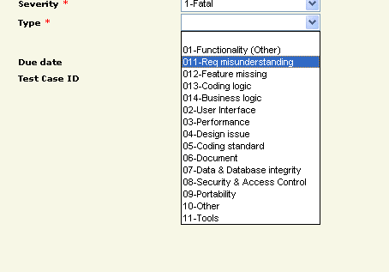
4
SUGGESTION
Multi language
There is no any blank value in the drop-down list (Type)

Slide 8
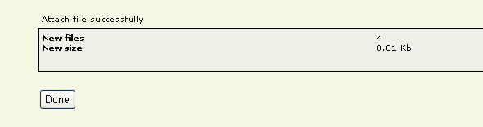
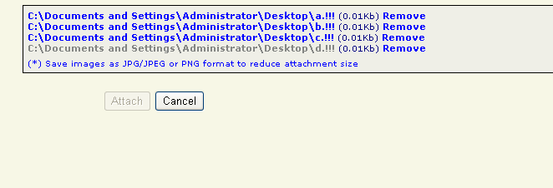
4
SUGGESTION
Display a message box when user attach file (successfully/unsuccessfully)
Press cancel button will showing message box

Slide 9
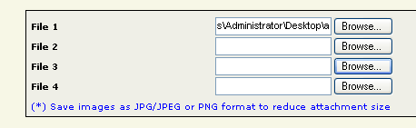
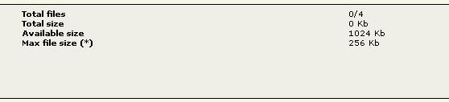
4
SUGGESTION
Select multiple files at once
Increase limitation for file size

Slide 10

THANK YOU

